Slide 1
Recommender System with Machine Learning
Bo-Yan Huang
2024 1/16

Slide 2

Outline
Introduction and Background
Exploratory Data Analysis
Content-based Recommender System using Unsupervised Learning
Collaborative-filtering based Recommender System using Supervised learning
Conclusion
Appendix

Slide 3
Introduction
Background:
In the era of digital education, our project aims to transform the learning landscape through an advanced recommender system. The mission is to enhance user experiences by seamlessly connecting learners with new, relevant courses, shaping personalized educational paths.
This initiative not only strives to improve user satisfaction but also anticipates a positive impact on company revenue. By facilitating user engagement with diverse courses, we envision a symbiotic relationship between learner contentment and business growth.

Slide 4
Introduction
Problem states:
Limited Course Discoverability: Users face challenges in discovering new and relevant courses that align with their interests and learning goals, leading to a suboptimal learning experience.
Underutilized Learning Paths: The absence of personalized recommendations may result in users not fully realizing the potential of a structured learning path, hindering their educational progression and engagement.
Revenue Growth Opportunities: The current lack of an effective recommender system may be limiting the company's revenue potential, as user interactions with courses could be suboptimal.

Slide 5
Introduction
Hypothesis:
Relevance Hypothesis: Implementing a recommender system will significantly improve the relevance of course recommendations for users, leading to increased user satisfaction.
Engagement Hypothesis: A personalized learning experience, facilitated by the recommender system, will boost user engagement with courses, contributing to a more active and committed user base.
Learning Path Optimization Hypothesis: The recommender system will optimize users' learning paths, guiding them towards a more structured and effective educational journey.
Revenue Impact Hypothesis: Enhanced user engagement through the recommender system will positively impact company revenue by increasing course enrollments and user interactions.
Model Performance Hypothesis: Through the Proof of Concept (PoC) phase, it is hypothesized that the exploration and comparison of various machine learning models will identify a model with superior performance in offline evaluations, setting the stage for effective online implementation.

Slide 6
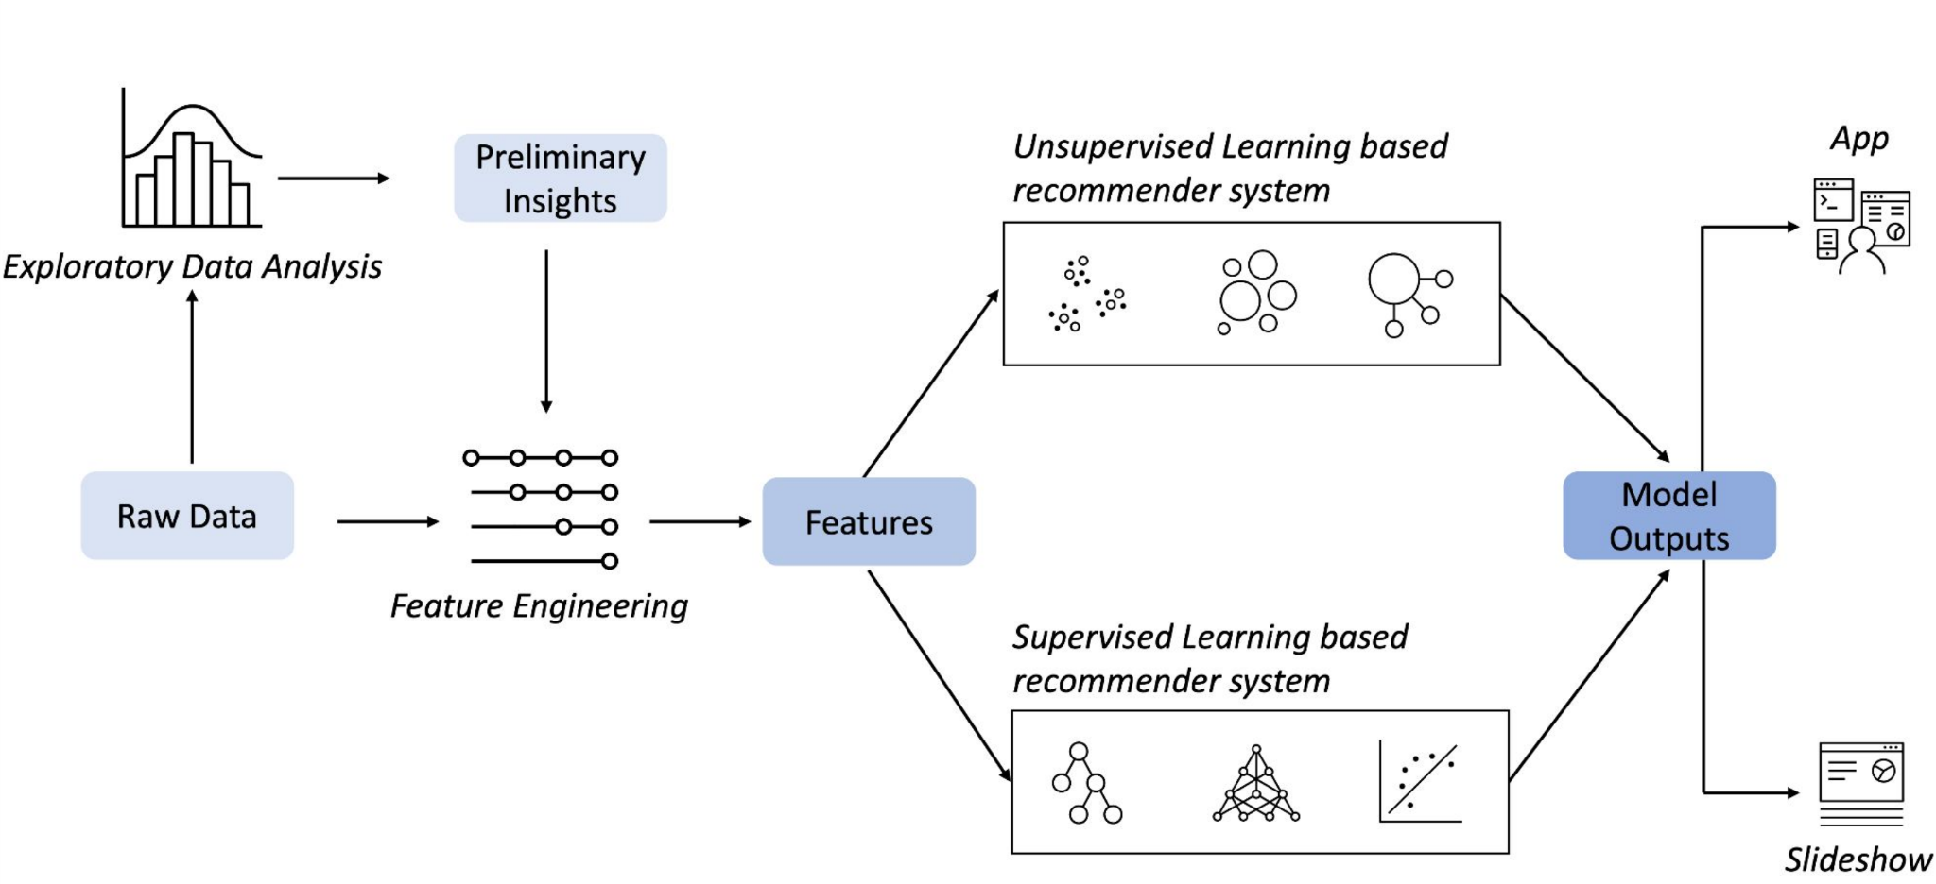
Machine Learning Workflow

Slide 7
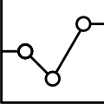
Exploratory Data Analysis
Steps:
Statistical Overview
Keyword Identification using WordCloud
Find Popular Course Genres
Summary Statistics and Visualizations for Enrollment Data

Slide 8
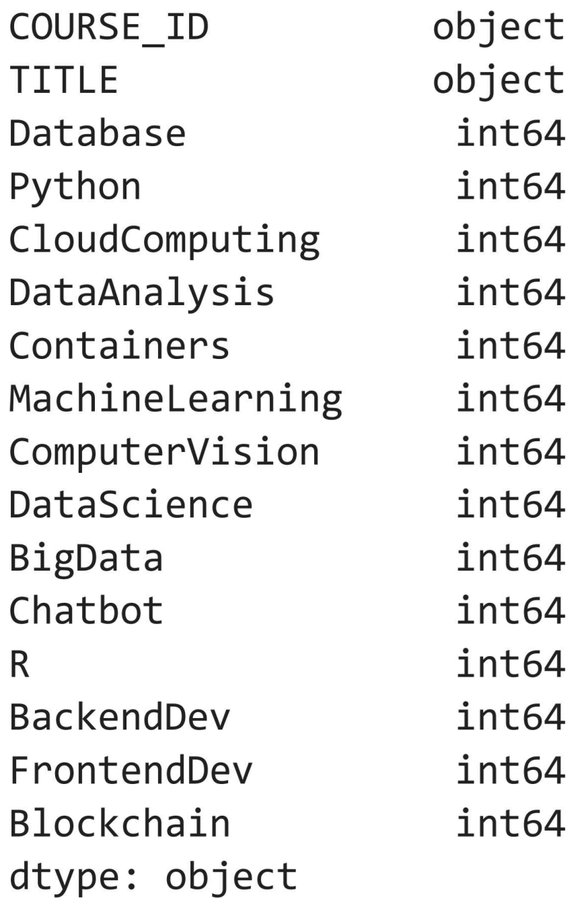
Columns/Features of the Data:

Slide 9
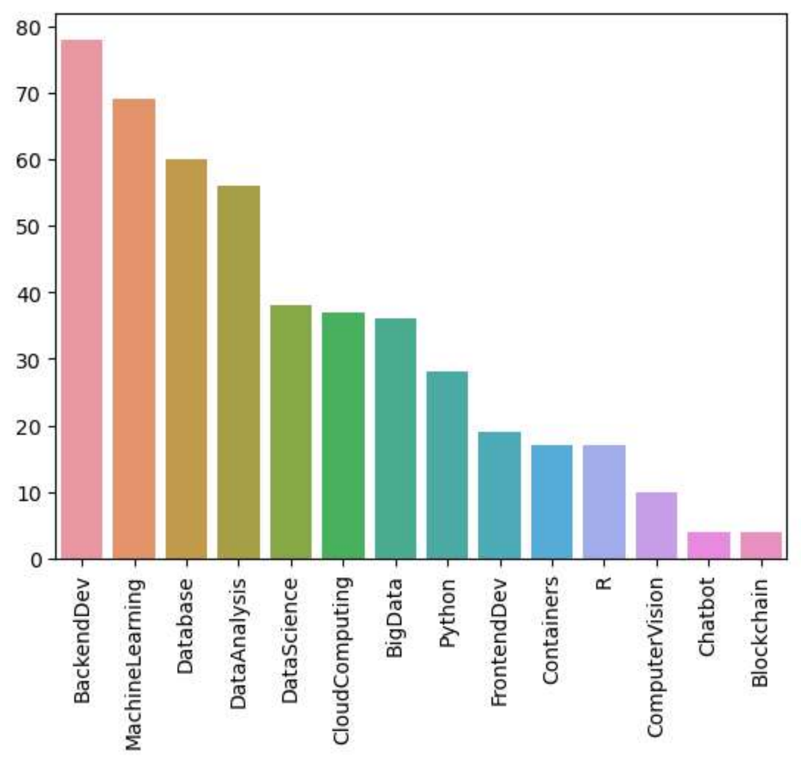
Enrollment counts per genre
Notes:
Backend Development, Machine Learning, and Database emerge as the most widely embraced genres, enjoying significant popularity. In contrast, Blockchain, Chatbot, and Computer Vision represent the less commonly explored niches within the dataset.

Slide 10
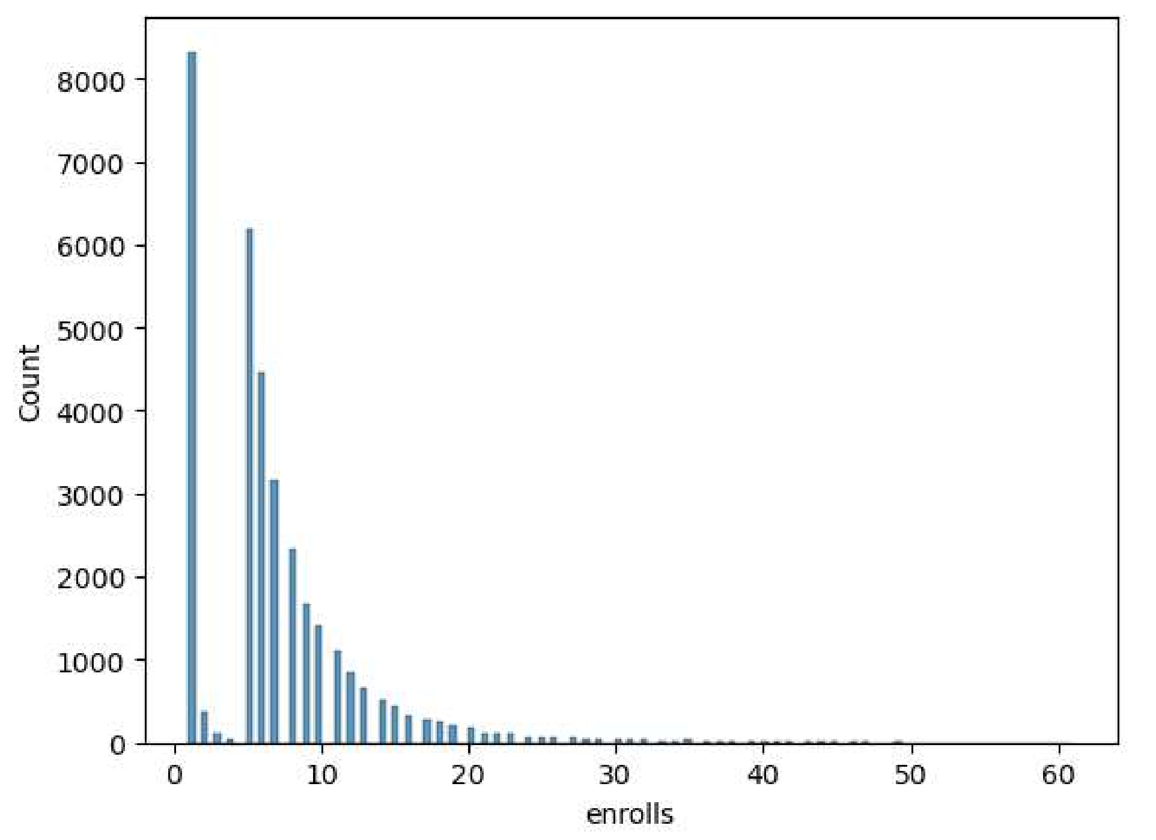
Course enrollment distribution
Notes:
The provided histogram depicts the distribution of user rating counts. The majority of users either refrained from rating any courses or did so infrequently. However, a small number of exceptional students gave ratings for more than 40 courses.

Slide 11
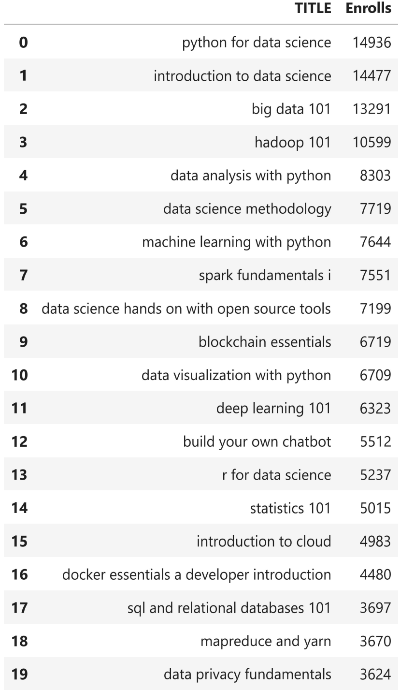
20 most popular courses
Notes:
The table below displays the top 20 widely-adopted courses. Nine out of the top 10 courses pertain to the data topic, with the 4th course being the sole representative of the software engineering topic.

Slide 12
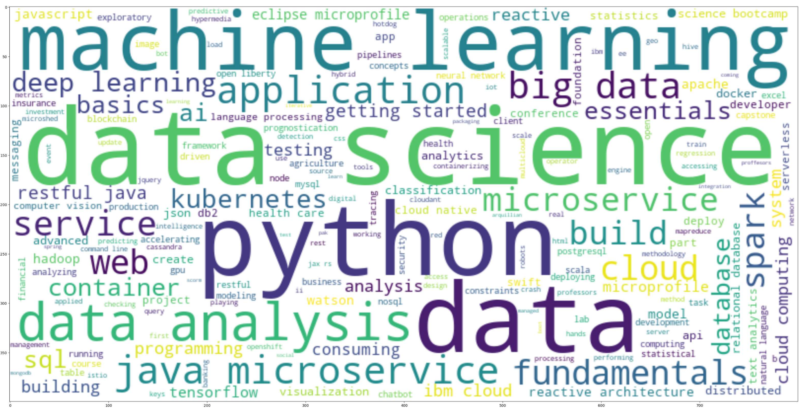
Identify keywords in course titles using a WordCloud
Top 10 omnipresences following by size:
1. data
2. data science
3. python
4. machine learning
5. data analysis
6. application
7. big data
8. java
9. microse
Notes:
As we can see from the `wordcloud`, there are many popular IT related keywords such as python, data science, machine learning, big data, ai, tensorflow, container, cloud, etc. By looking at these keywords, we should have a general understanding that the courses in the dataset are focused on demanding IT skills.

Slide 13
Content-based Recommender System using Unsupervised Learning
Cluster2
Cluster1

Slide 14
Flowchart of content-based recommender
using user profile and course genres
Raw data
User/Item feature engineering
Evaluate recommend score
Recommend courses
Course genres dataframe:
course_id, title, [genre_x, genre_y,...]
User dataframe:
user_id, [genre_interest_x, genre_interest_y,...]
Analyze data
Drop the outliers Normalize data
Extract features from users and courses (such as genres or BoW features)
Use the dot product between the user profile feature vectors and course genre feature vectors obtain the recommend scores / similarities
Make predictions by setting a threshold on recommend scores

Slide 15
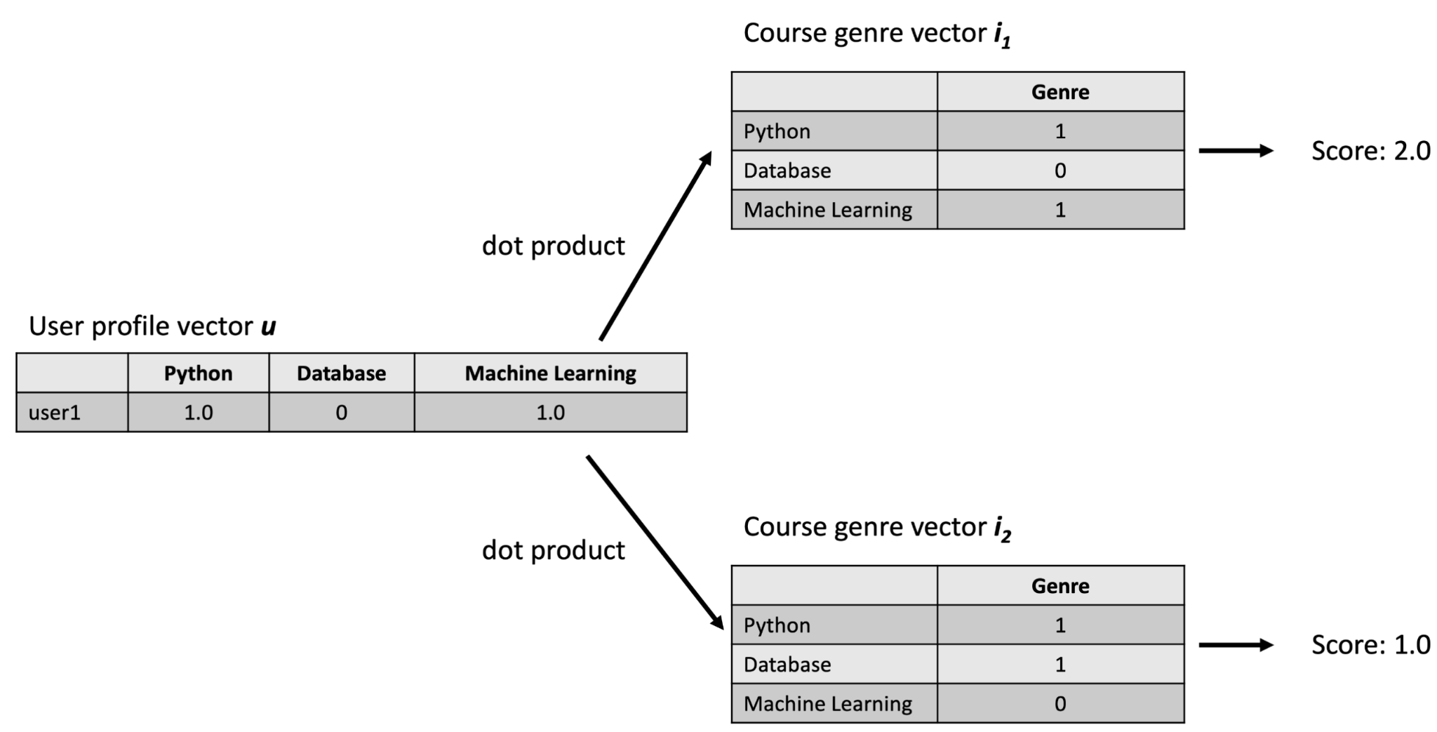
Flowchart of content-based recommender
using user profile and course genres
Evaluate recommend score
Use the dot product between the user profile feature vectors and course genre feature vectors obtain the similarities
Notes:
Next, how can we calculate a recommendation score for each new course with respect to users, using user profile vectors and genre vectors?
One simple but effective way is to apply the dot product to the user profile vector and course genre vector (as they always have the same shape). Since we have two users and three courses, we need to perform a matrix multiplication:

Slide 16
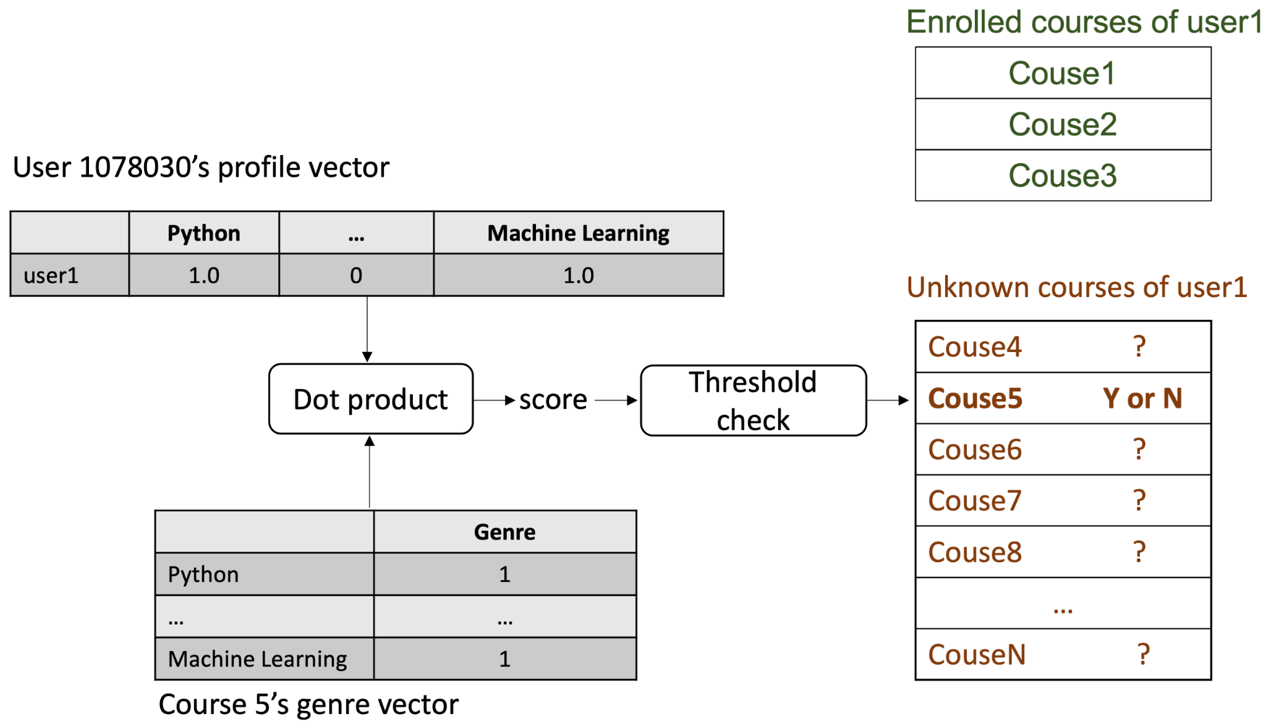
Flowchart of content-based recommender
using user profile and course genres
Recommend courses
Make predictions by setting a threshold on recommend scores
Notes:
Then, we need to choose a recommendation score threshold. If the score of any course is above the threshold, we may recommend that course to the user.

Slide 17
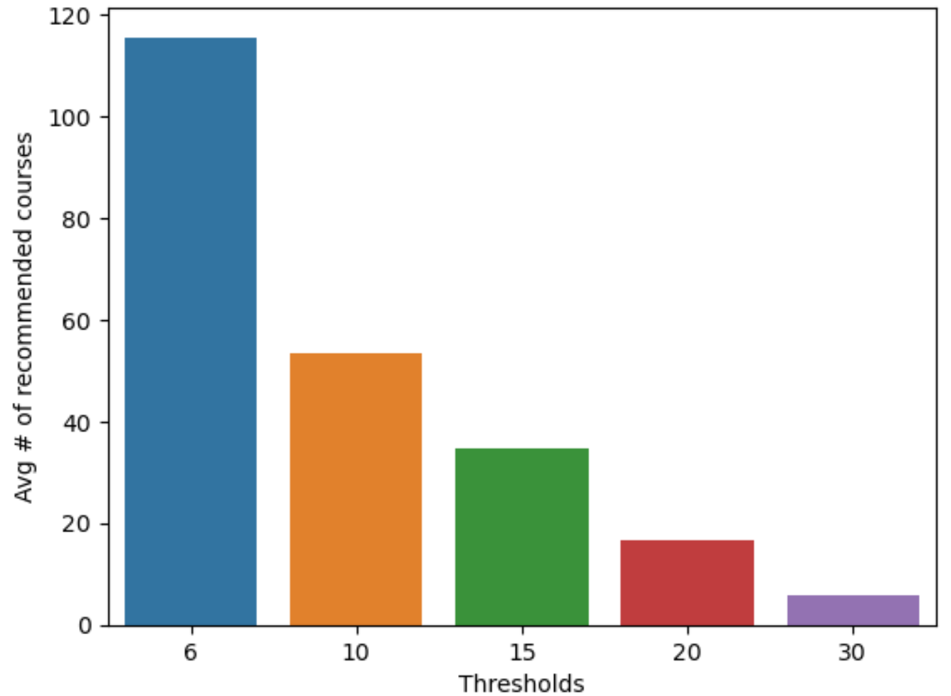
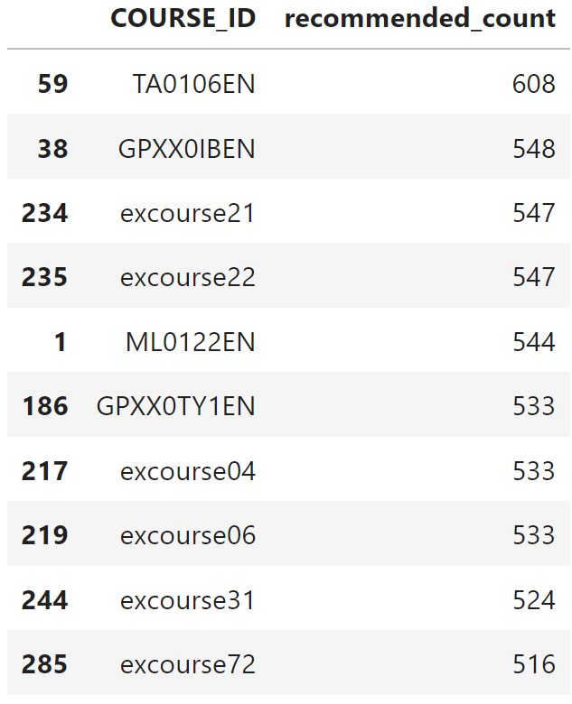
Evaluation results of user profile-based recommender system
In the lower left chart, we varied the threshold from 6 to 30. To ensure approximately 10 recommended courses per user, we set the threshold to 25 in order to calculate the top-10 commonly recommended courses in the lower right.
Notes:
The lower left plot displays the average number of new or unseen courses recommended per user in the test dataset (~1000 samples). Meanwhile, the lower right plot illustrates the top-10 commonly recommended courses.
In the lower left chart, we varied the threshold from 6 to 30. To ensure approximately 10 recommended courses per user, we set the threshold to 25 in order to calculate the top-10 commonly recommended courses in the lower right.

Slide 18
Flowchart of content-based recommender system using course similarity
Raw data
User/Item feature engineering
Evaluate recommend score
Recommend courses
Course genres dataframe:
course_id, title, [genre_x, genre_y,...]
User dataframe:
user_id, course_id
Analyze data
Drop the outliers Normalize data
Extract features from courses (such as genres or BoW features)
Find courses which are similar enough to your enrolled courses.
Make predictions by setting a threshold on recommend scores
Notes:
What if we don’t know user’s preferred genre of courses? We can instead find courses which are similar enough to your enrolled courses.

Slide 19
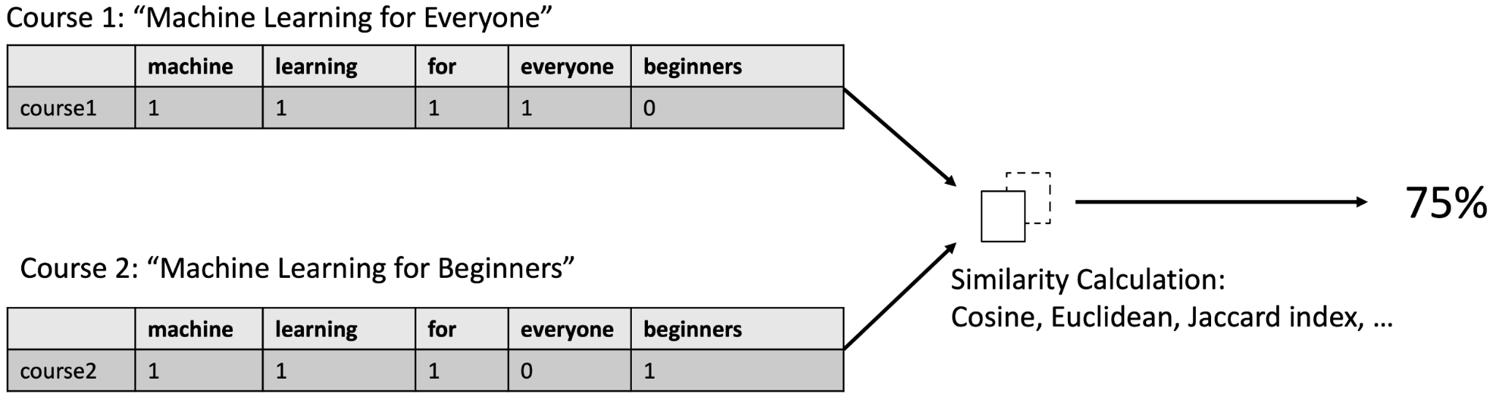
Flowchart of content-based recommender system using course similarity
Evaluate recommend score
Find courses which are similar enough to your enrolled courses.
In our example, we use cosine approach as previous one.
Notes:
Next, how can we calculate a recommendation score for each new course with respect to users, using user profile vectors and genre vectors?
One simple but effective way is to apply the dot product to the user profile vector and course genre vector (as they always have the same shape). Since we have two users and three courses, we need to perform a matrix multiplication:

Slide 20
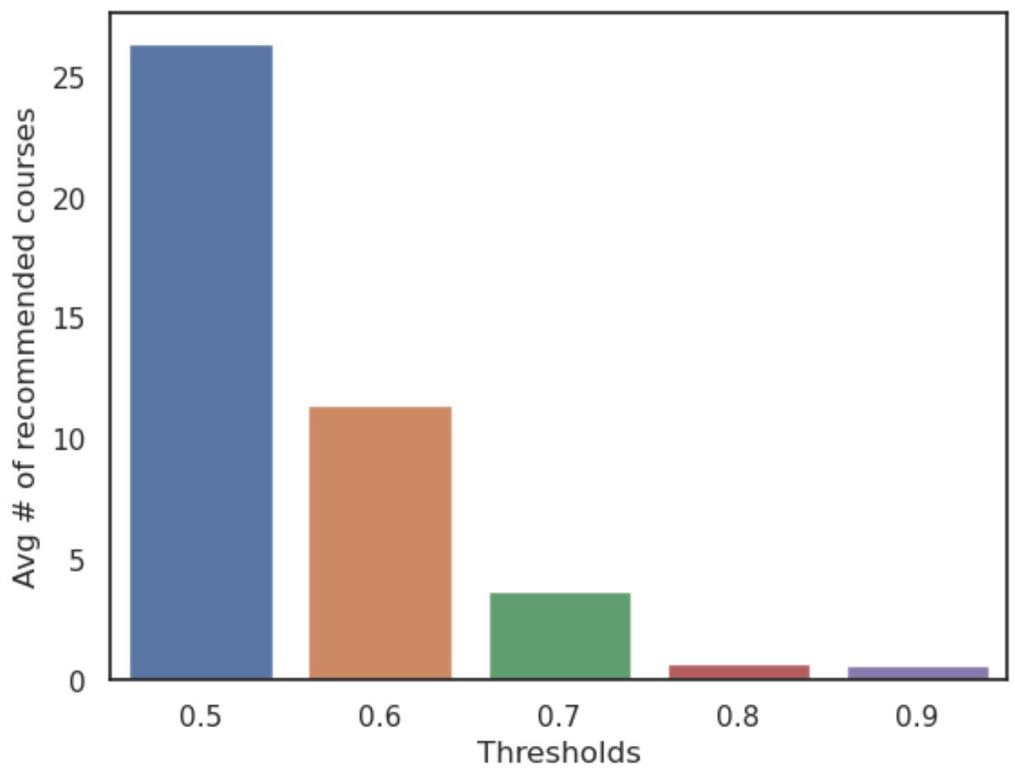
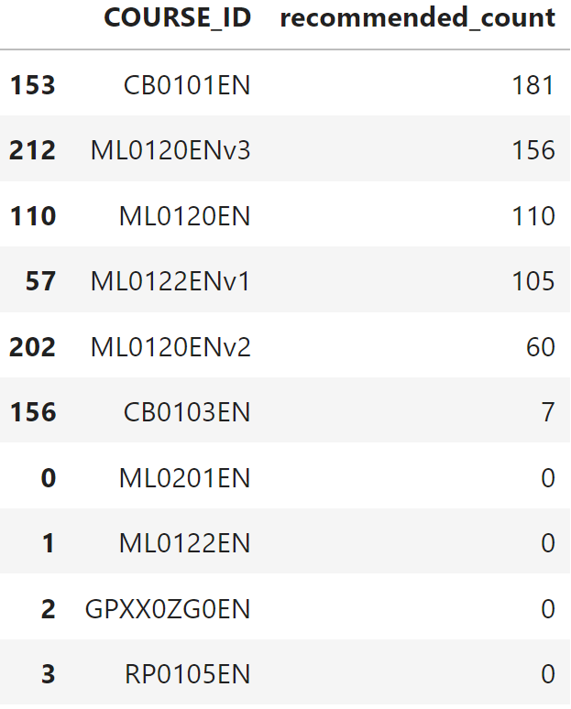
Evaluation results of course similarity based recommender system
In the lower left chart, we varied the threshold from 0.5 to 0.9. To ensure approximately 10 recommended courses per user, we set the threshold to 0.6 in order to calculate the top-10 commonly recommended courses in the lower right.
Notes:
The lower left plot displays the average number of new or unseen courses recommended per user in the test dataset (~1000 samples). Meanwhile, the lower right plot illustrates the top-10 commonly recommended courses.
In the lower left chart, we varied the threshold from 6 to 30. To ensure approximately 10 recommended courses per user, we set the threshold to 25 in order to calculate the top-10 commonly recommended courses in the lower right.

Slide 21
Flowchart of clustering-based recommender system
Raw data
User/Item feature engineering
Group users
Recommend courses
Course genres dataframe:
course_id, title, [genre_x, genre_y,...]
User dataframe:
user_id, [genre_interest_x, genre_interest_y,...]
Extract features from users such as enrollments or genres
Apply PCA on user profile feature vectors to reduce dimensions
Divide users into several groups based on their enrollments or genres
Recommend popular courses according to the preferences of other users within the same group.
Notes:
Now we divided users into several groups based on their enrollments.

Slide 22
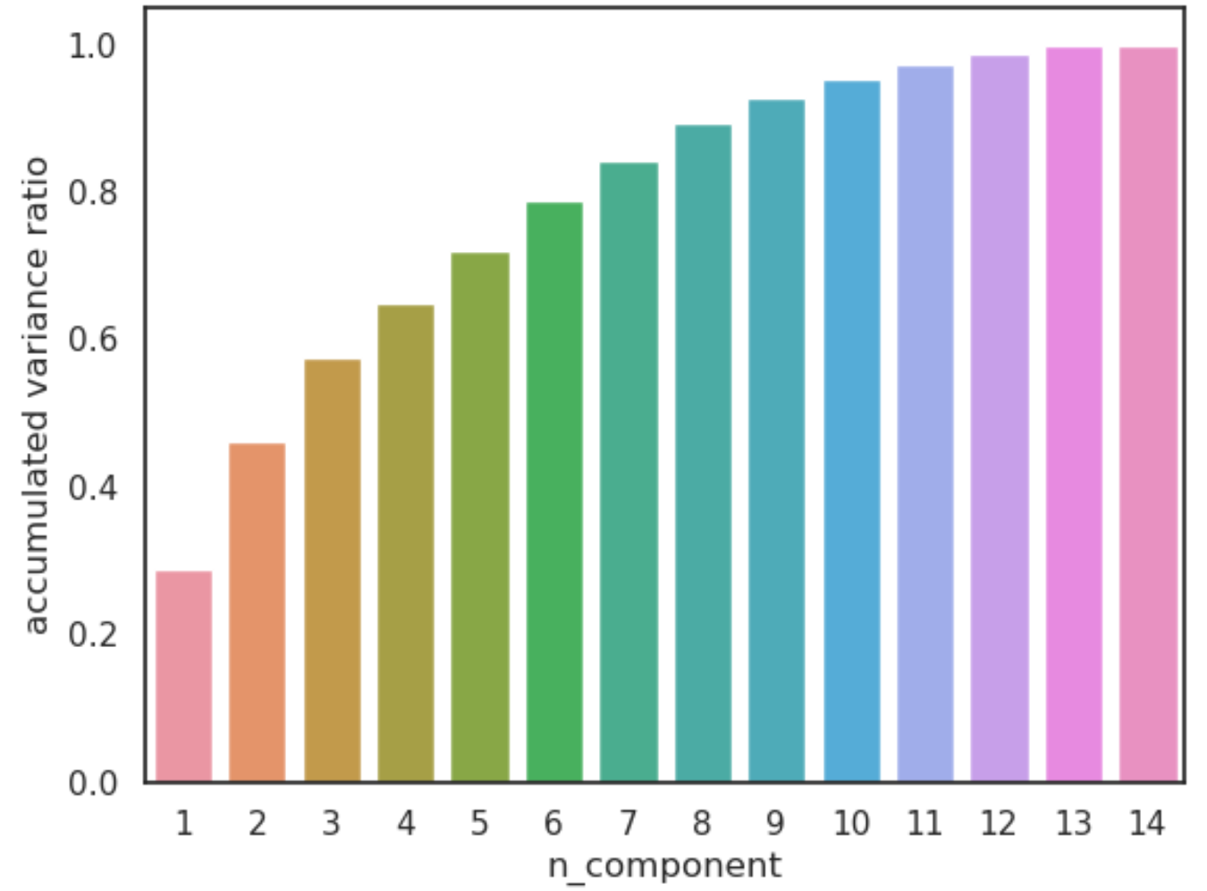
Flowchart of clustering-based recommender system
User/Item feature engineering
Extract features from users such as enrollments or genres
Apply PCA on user profile feature vectors to reduce dimensions
Notes:
If we plot a covariance matrix of the user profile feature vectors with 14 features, we can observe that some features are actually correlated.
For example it is obvious that the feature MachineLearning and the feature DataScience are correlated.
Such covariances among features may indicate that we can apply PCA to find its main components (eigenvectors with max eigenvalues on the covariance matrix).
If we only keep the independent main components, then we can reduce the dimensions of our user profile feature vectors.
If the accumulated variances ratio of a candidate n_components is larger than a threshold, e.g., 90%, then we can say the transformed n_components could explain about 90% of variances of the original data variance and can be considered as an optimized components size.

Slide 23
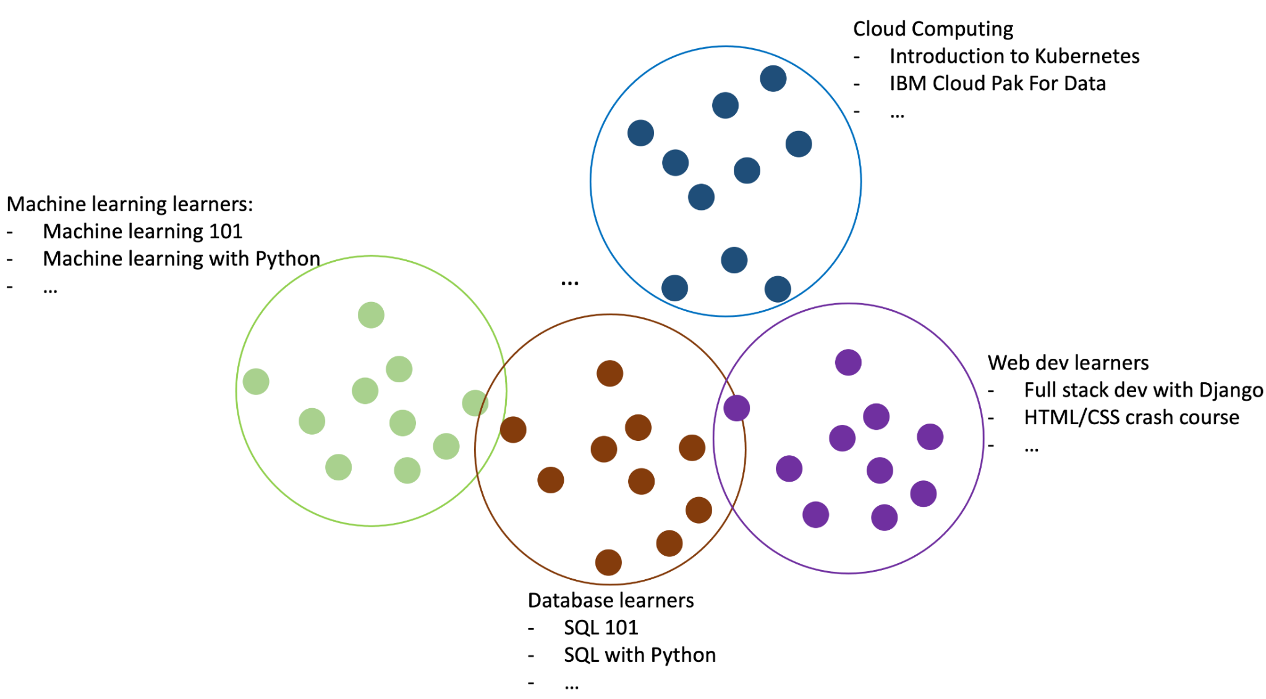
Flowchart of clustering-based recommender system
Group users
Divide users into several groups based on their enrollments or genres
Notes:
For each user group, we can come up with a list of popular courses. For example, for the machine learning user cluster/learning group, we can count the most frequently enrolled courses, which are very likely to be the most popular and good machine learning courses because they are enrolled by many users who are interested in machine learning.
If we know a user belongs to the machine learning group, we may recommend the most enrolled courses to them and it is very likely the user will be interested in them.

Slide 24
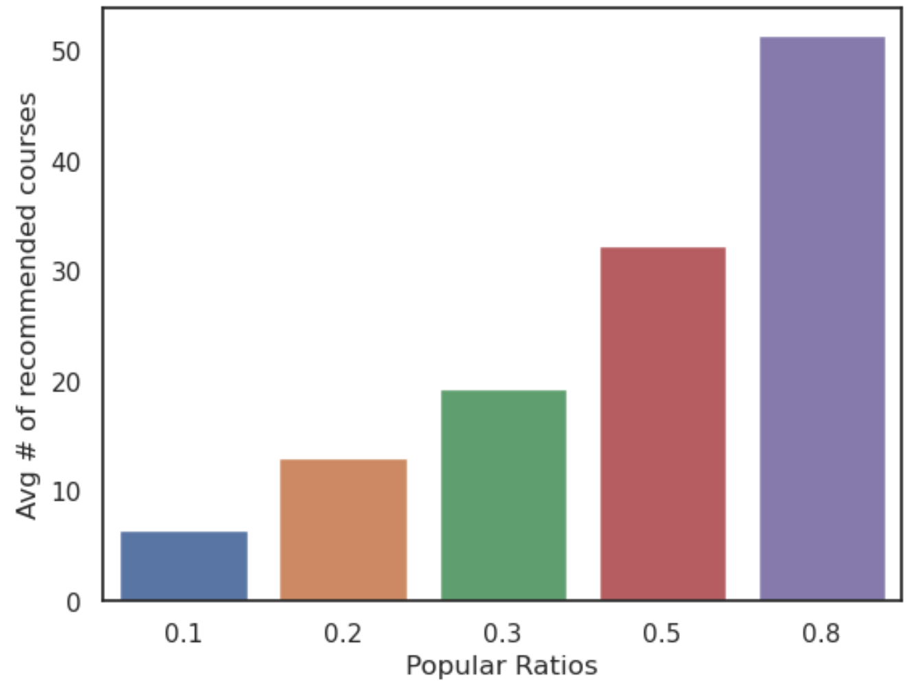
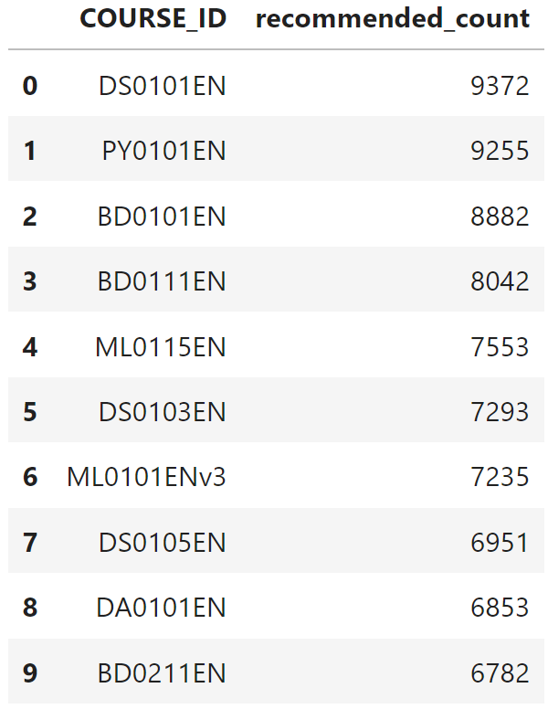
Evaluation results of clustering-based recommender system
In the lower left chart, we vary the popular ratio range from 0.1 to 0.8, maintaining the PCA features at 9 and n_clusters at 30. To attain approximately 10 recommended courses per user, we set the popular ratio to 0.2. The popular ratio is defined as the ratio of all enrollments within the cluster to which the user belongs.
Notes:
The lower left plot displays the average number of new or unseen courses recommended per user in the test dataset (~10000 samples). Meanwhile, the lower right plot illustrates the top-10 commonly recommended courses.
In the lower left chart, we vary the threshold range from 0.1 to 0.8, maintaining the PCA features at 9 and n_clusters at 30. To attain approximately 10 recommended courses per user, we set the popular ratio to 0.2. The popular ratio is defined as the ratio of all enrollments within the cluster to which the user belongs.

Slide 25
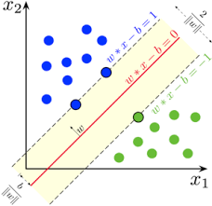
Collaborative-filtering Recommender System using Supervised Learning

Slide 26
Flowchart of KNN based recommender system
User/Item feature engineering
KNN-based collaborative filtering
Raw data
Predict course ratings
Course genres dataframe:
course_id, title, course_rating
User dataframe:
user_id,
enrollment,
course_ratings
Extract features from users such as enrollments or genres
Build User-item interaction matrix
Perform KNN-based collaborative filtering on the user-item interaction matrix
Compute prediction ratings using the trained KNN model.
Notes:
Now we divided users into several groups based on their enrollments.

Slide 27
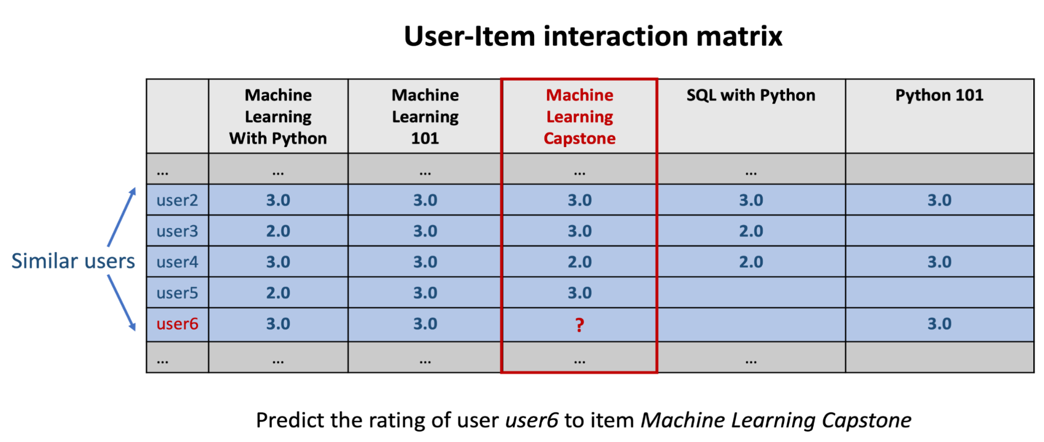
Flowchart of clustering-based recommender system
User/Item feature engineering
Extract features from users such as enrollments or genres
Build User-item interaction matrix
Notes:
For most collaborative filtering-based recommender systems, the main dataset format is a 2-D matrix called the user-item interaction matrix. In the matrix, its row is labeled as the user id/index and column labelled to be the item id/index, and the element (i, j) represents the rating of user i to item j.
Each row vector represents the rating history of a user and each column vector represents the users who rated the item. A user-item interaction matrix is usually very sparse as you can imagine one user very likely only interacts with a very small subset of items and one item is very likely to be interacted by a small subset of users.
Usually, the dense format is more preferred as it saves a lot of storage and memory space. While the benefit of the sparse matrix is it is in the nature matrix format and you could apply computations such as cosine similarity directly.

Slide 28
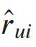
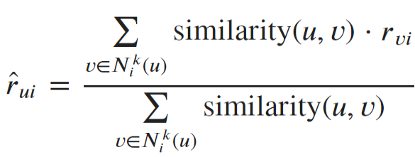
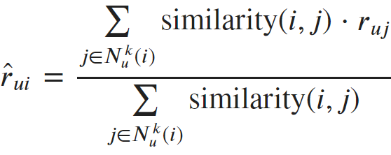
Flowchart of KNN based recommender system
The predicted rating of user 𝑢 to item 𝑖, is given by:
Predict course ratings
User-based collaborative filtering:
Compute prediction ratings using the trained KNN model.
Item-based collaborative filtering:
Notes:
Now to determine if two users are similar, we can simply calculate the similarities between their row vectors in the interaction matrix. Then based on the similarity measurements, we can find the k nearest neighbor as the similar users.
For item-based filtering, we just need to look at the user-item matrix vertically. Instead of finding similar users, we are trying to find similar items (courses). If two courses are enrolled by two groups of similar users, then we could consider the two items are similar and use the known ratings from the other users to predict the unknown ratings.

Slide 29
Flowchart of NMF based recommender system
User/Item feature engineering
Non-negative Matrix Factorization
Raw data
Predict course ratings
Course genres dataframe:
course_id, title, course_rating
User dataframe:
user_id,
enrollment,
course_ratings
Choose the Number of Components (Rank)
Initialize Factors W and H
Derive the latent user and item features through Non-negative Matrix Factorization (NMF)
Dot-product the latent features of users and items to get an estimated rating

Slide 30
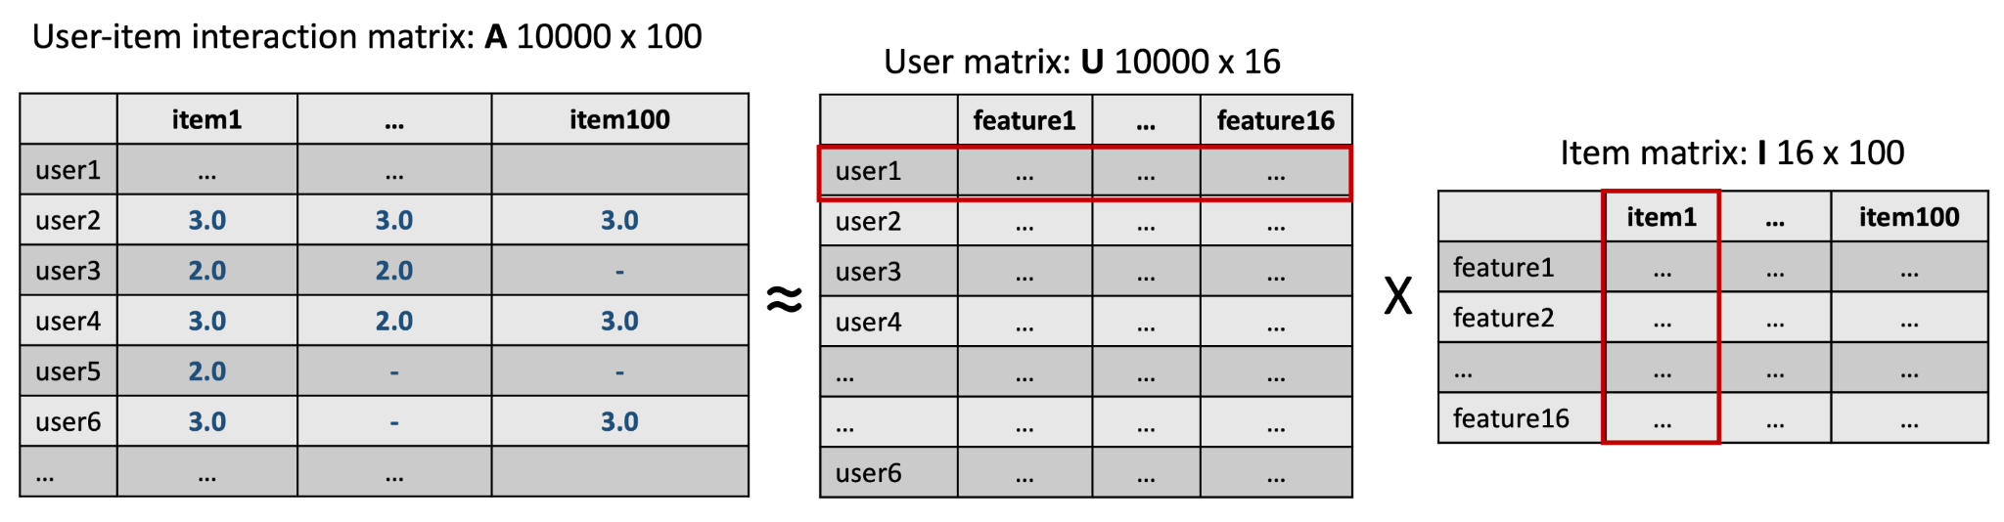
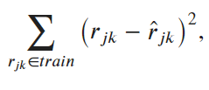
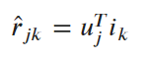
Flowchart of NMF based recommender system
Non-negative Matrix Factorization
Extract the latent user and item features
Notes:
Then how do we figure out the values in
𝑈 and 𝐼 exactly? Like many other machine learning processes, we could start by initializing the values of
𝑈 and 𝐼, then define the following distance or cost function to be minimized:
Note 𝐼 is short for Items, and it is not an identity matrix.
The cost function can be optimized using stochastic gradient descent (SGD) or other optimization algorithms, just like in training the weights in a logistic regression model (there are several additional steps so the matrices have no negative elements) .
In addition to NMF, neural networks can also be used to extract the latent user and item features? In fact, neural networks are very good at learning patterns from data and are widely used to extract latent features.

Slide 31
Flowchart of Neural Network Embedding based recommender system
User/Item feature engineering
NN encoder
Raw data
Predict course ratings
Course genres dataframe:
course_id, title, course_rating
User dataframe:
user_id,
enrollment,
course_ratings
Extract features from users and items such as genres
Extract the latent user and item features using Neural Network(NN)
Dot-product the latent features of users and items to get an estimated rating

Slide 32
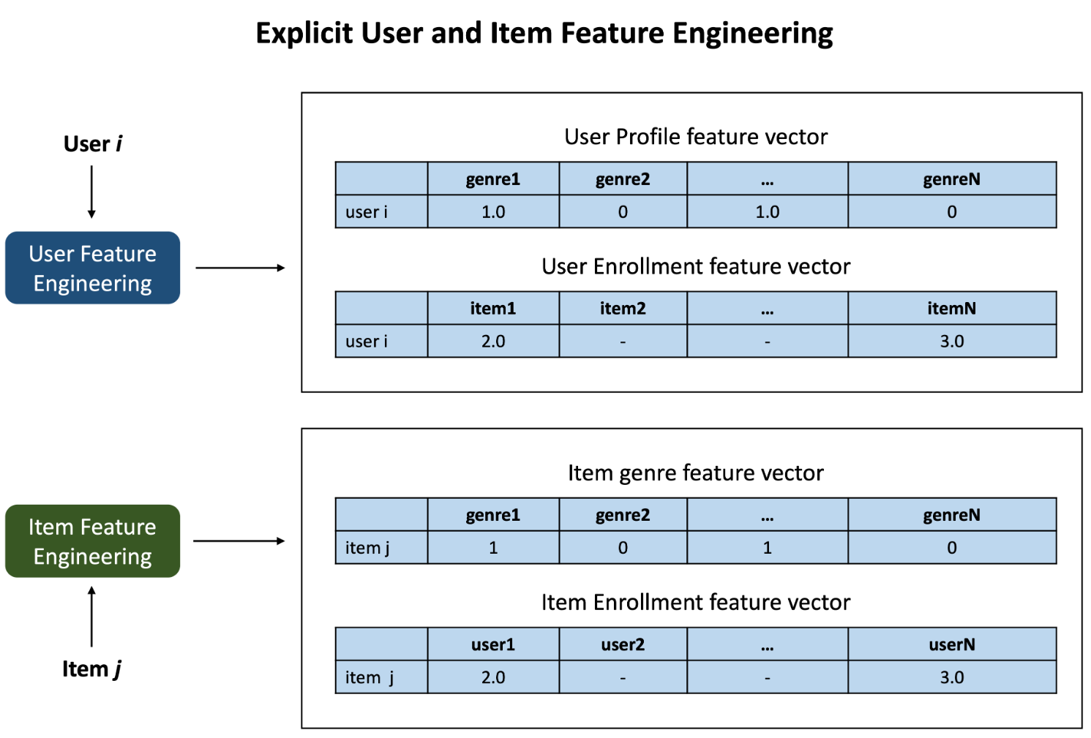
Flowchart of Neural Network Embedding based recommender system
User/Item Feature engineering
Extract features from users and items such as genres
Notes:
For user i, build profile feature vector and course rating feature vector, and given an item j to create genre vector and user enrollment vectors.

Slide 33
Flowchart of Neural Network Embedding based recommender system
NN encoder
Extract the latent user and item features using Neural Network(NN)
Notes:
As previously discussed in the NMF section, neural networks can also serve as a tool for extracting latent user and item features. Neural networks excel in learning patterns from data and are extensively employed for uncovering latent features. During the training process of neural networks, these models gradually assimilate and encode features within their hidden layers through weight matrices, which can then be extracted to represent the underlying data.

Slide 34
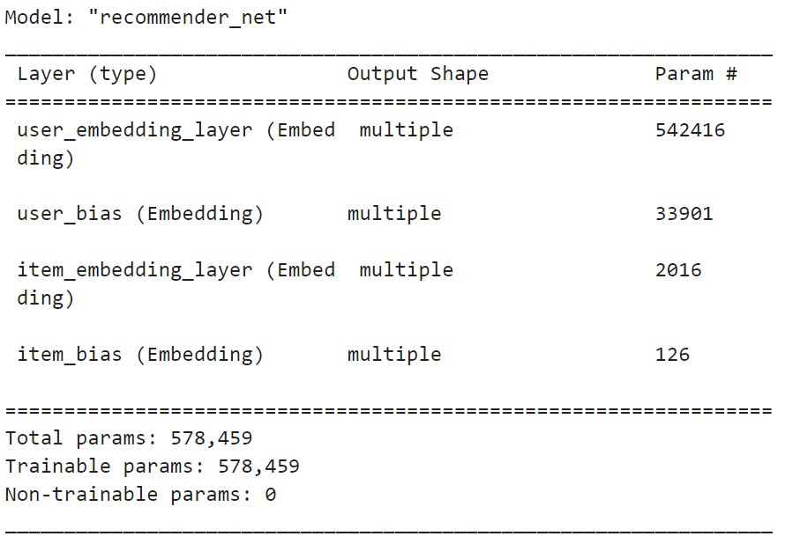
Flowchart of Neural Network Embedding based recommender system
NN encoder
Extract the latent user and item features using Neural Network(NN)
Notes:
The network inputs are two one-hot encoding vectors, the blue one is for the user and the green one is for the item. Then on top of them, we added two embedding layers. Here embedding means embedding the one-hot encoding vector into a latent feature space. The embedding layer is a fully-connected layer that outputs the embedding feature vectors. For example, the user embedding layer takes `33901 x 1` one-hot vector as input and outputs a `16 x 1` embedding vector.

Slide 35
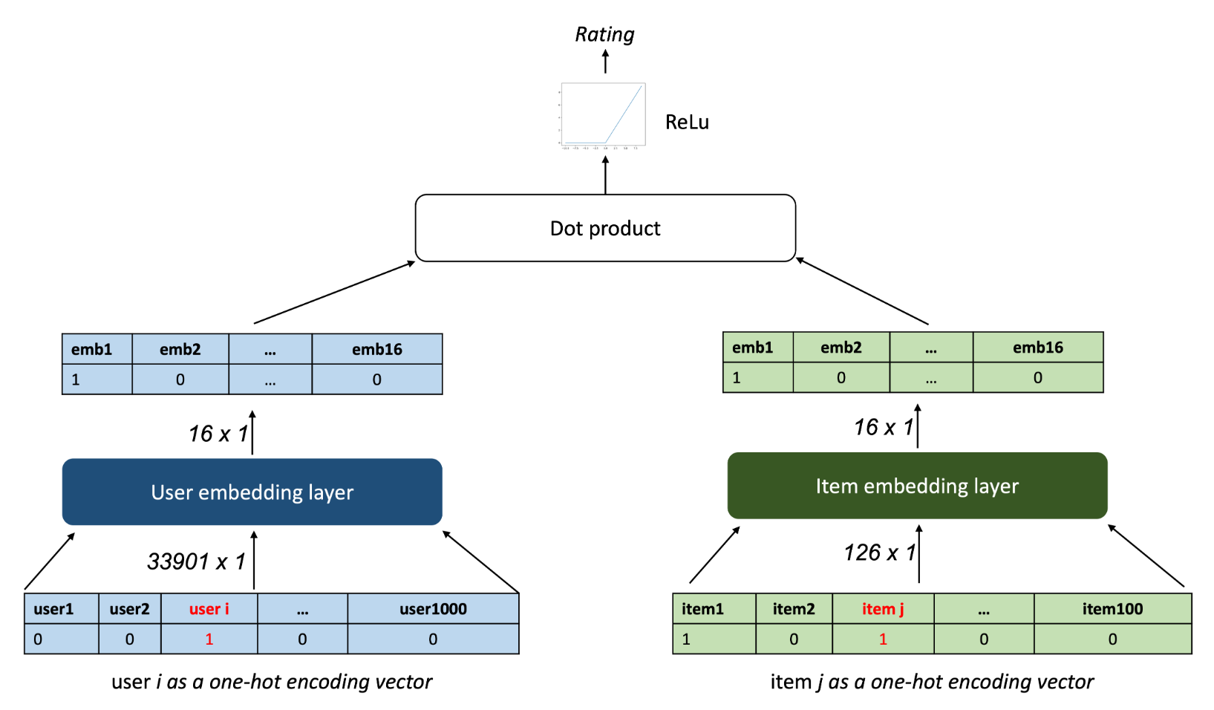
Flowchart of Neural Network Embedding based recommender system
Predict course ratings
Dot-product the latent features of users and items to get an estimated rating
Notes:
The embedding layer outputs two embedding vectors, which are similar to Non-negative matrix factorization. Then we could simply dot the product the user and item embedding vector to output a rating estimation.
The Non-negative Matrix Factorization decomposes the user-item interaction matrix into user matrix and item matrix, which contain the latent features of users and items and you can simply dot-product them to get an estimated rating

Slide 36
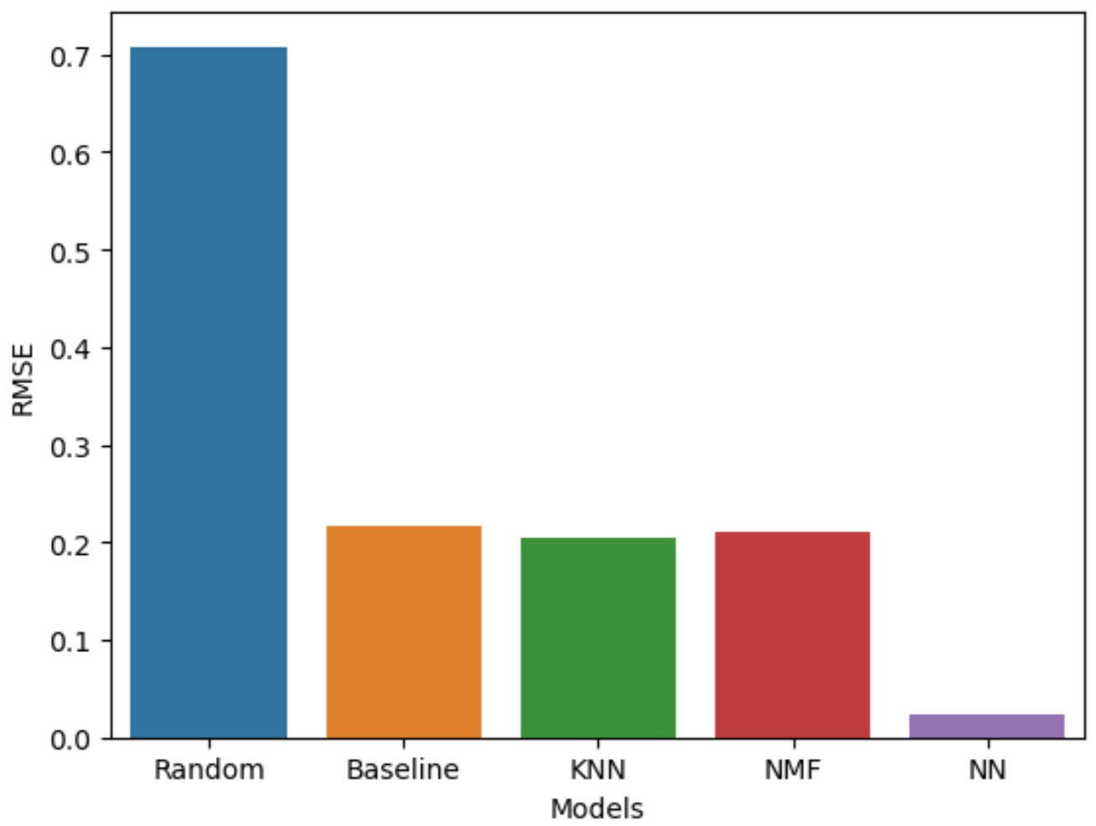
Compare the performance of collaborative-filtering models
Notes:
We've tested various collaborative-filtering models, including KNN, NMF, and NN. The "Random" classifier is a completely random predictor, generating predictions uniformly at random from the observed unique classes in y, ensuring each class has equal probability.
For baseline performance, we utilize the "predict" method, which consistently returns the most frequent class label observed in the y passed during fitting. The "predict_proba" method always provides the empirical class distribution of y, commonly known as the empirical class prior distribution. This baseline approach performs well because people often assign scores, such as 4 out of 5, most frequently. Therefore, a predictor that consistently returns 4 is expected to perform well.
Note that the neural network model exhibits exceptional performance, attributed to its capacity to learn complex non-linear relationships within the data.

Slide 37
Conclusions
We can recommend courses based on the similarity in genre in their profiles and suggest courses or based on the similarity in the enrollments of the users and suggest courses.
Grouping users according to the genre in their profiles allows us to recommend courses that are popular within the same cluster.
Applying PCA to user profile feature vectors can decrease dimensions, consequently reducing computational power requirements.
Course recommendations can be generated by predicting course ratings through KNN-based collaborative filtering.
Deriving latent user and item features through Non-negative Matrix Factorization (NMF) or Neural Network (NN) allows us to estimate course ratings and, hence, recommend courses.

Slide 38
Outlook - Possible issues
Cluster Interpretability: Understanding and interpreting the meaning of clusters can be difficult. Without clear domain knowledge, it might be challenging to explain why certain items or users are grouped together.
Dynamic Nature of Data: User preferences and item popularity can change over time. Unsupervised models might struggle to adapt to dynamic shifts in user behavior and preferences.
Lack of Personalization: Traditional clustering methods might not capture individual user preferences well, leading to less personalized recommendations.
Evaluation Metrics: Selecting appropriate evaluation metrics for unsupervised recommendation systems is challenging. Defining what constitutes a "good" clustering can be subjective.

Slide 39
Outlook -Possible solutions:
Cluster Interpretability: Gather user-generated course ratings and construct an interpretable supervised machine learning model, such as a decision tree, to elucidate the characteristics of the identified clusters.
Dynamic Nature of Data: Periodically retrain the model with updated data to adapt to changes in user preferences and item popularity over time.
Lack of Personalization: Combine clustering with user-specific features or collaborative filtering methods to enhance the personalization of recommendations.
Evaluation Metrics: Define and use appropriate evaluation metrics based on the specific goals of the recommendation system. Incorporate user feedback and conduct A/B testing to assess the real-world impact of recommendations. Additionally, assessing supervised learning score prediction accuracy can offer a valuable method for evaluating the system.

Slide 40
Appendix
Data source:
https://cf-courses-data.s3.us.cloud-object-storage.appdomain.cloud/IBM-ML321EN-SkillsNetwork/labs/datasets/sim.csv
https://cf-courses-data.s3.us.cloud-object-storage.appdomain.cloud/IBM-ML321EN-SkillsNetwork/labs/datasets/user_profile.csv
https://cf-courses-data.s3.us.cloud-object-storage.appdomain.cloud/IBM-ML321EN-SkillsNetwork/labs/datasets/course_genre.csv
Courses:
https://www.coursera.org/learn/ibm-unsupervised-machine-learning/home
Jupyter notebook:

